Slide 1
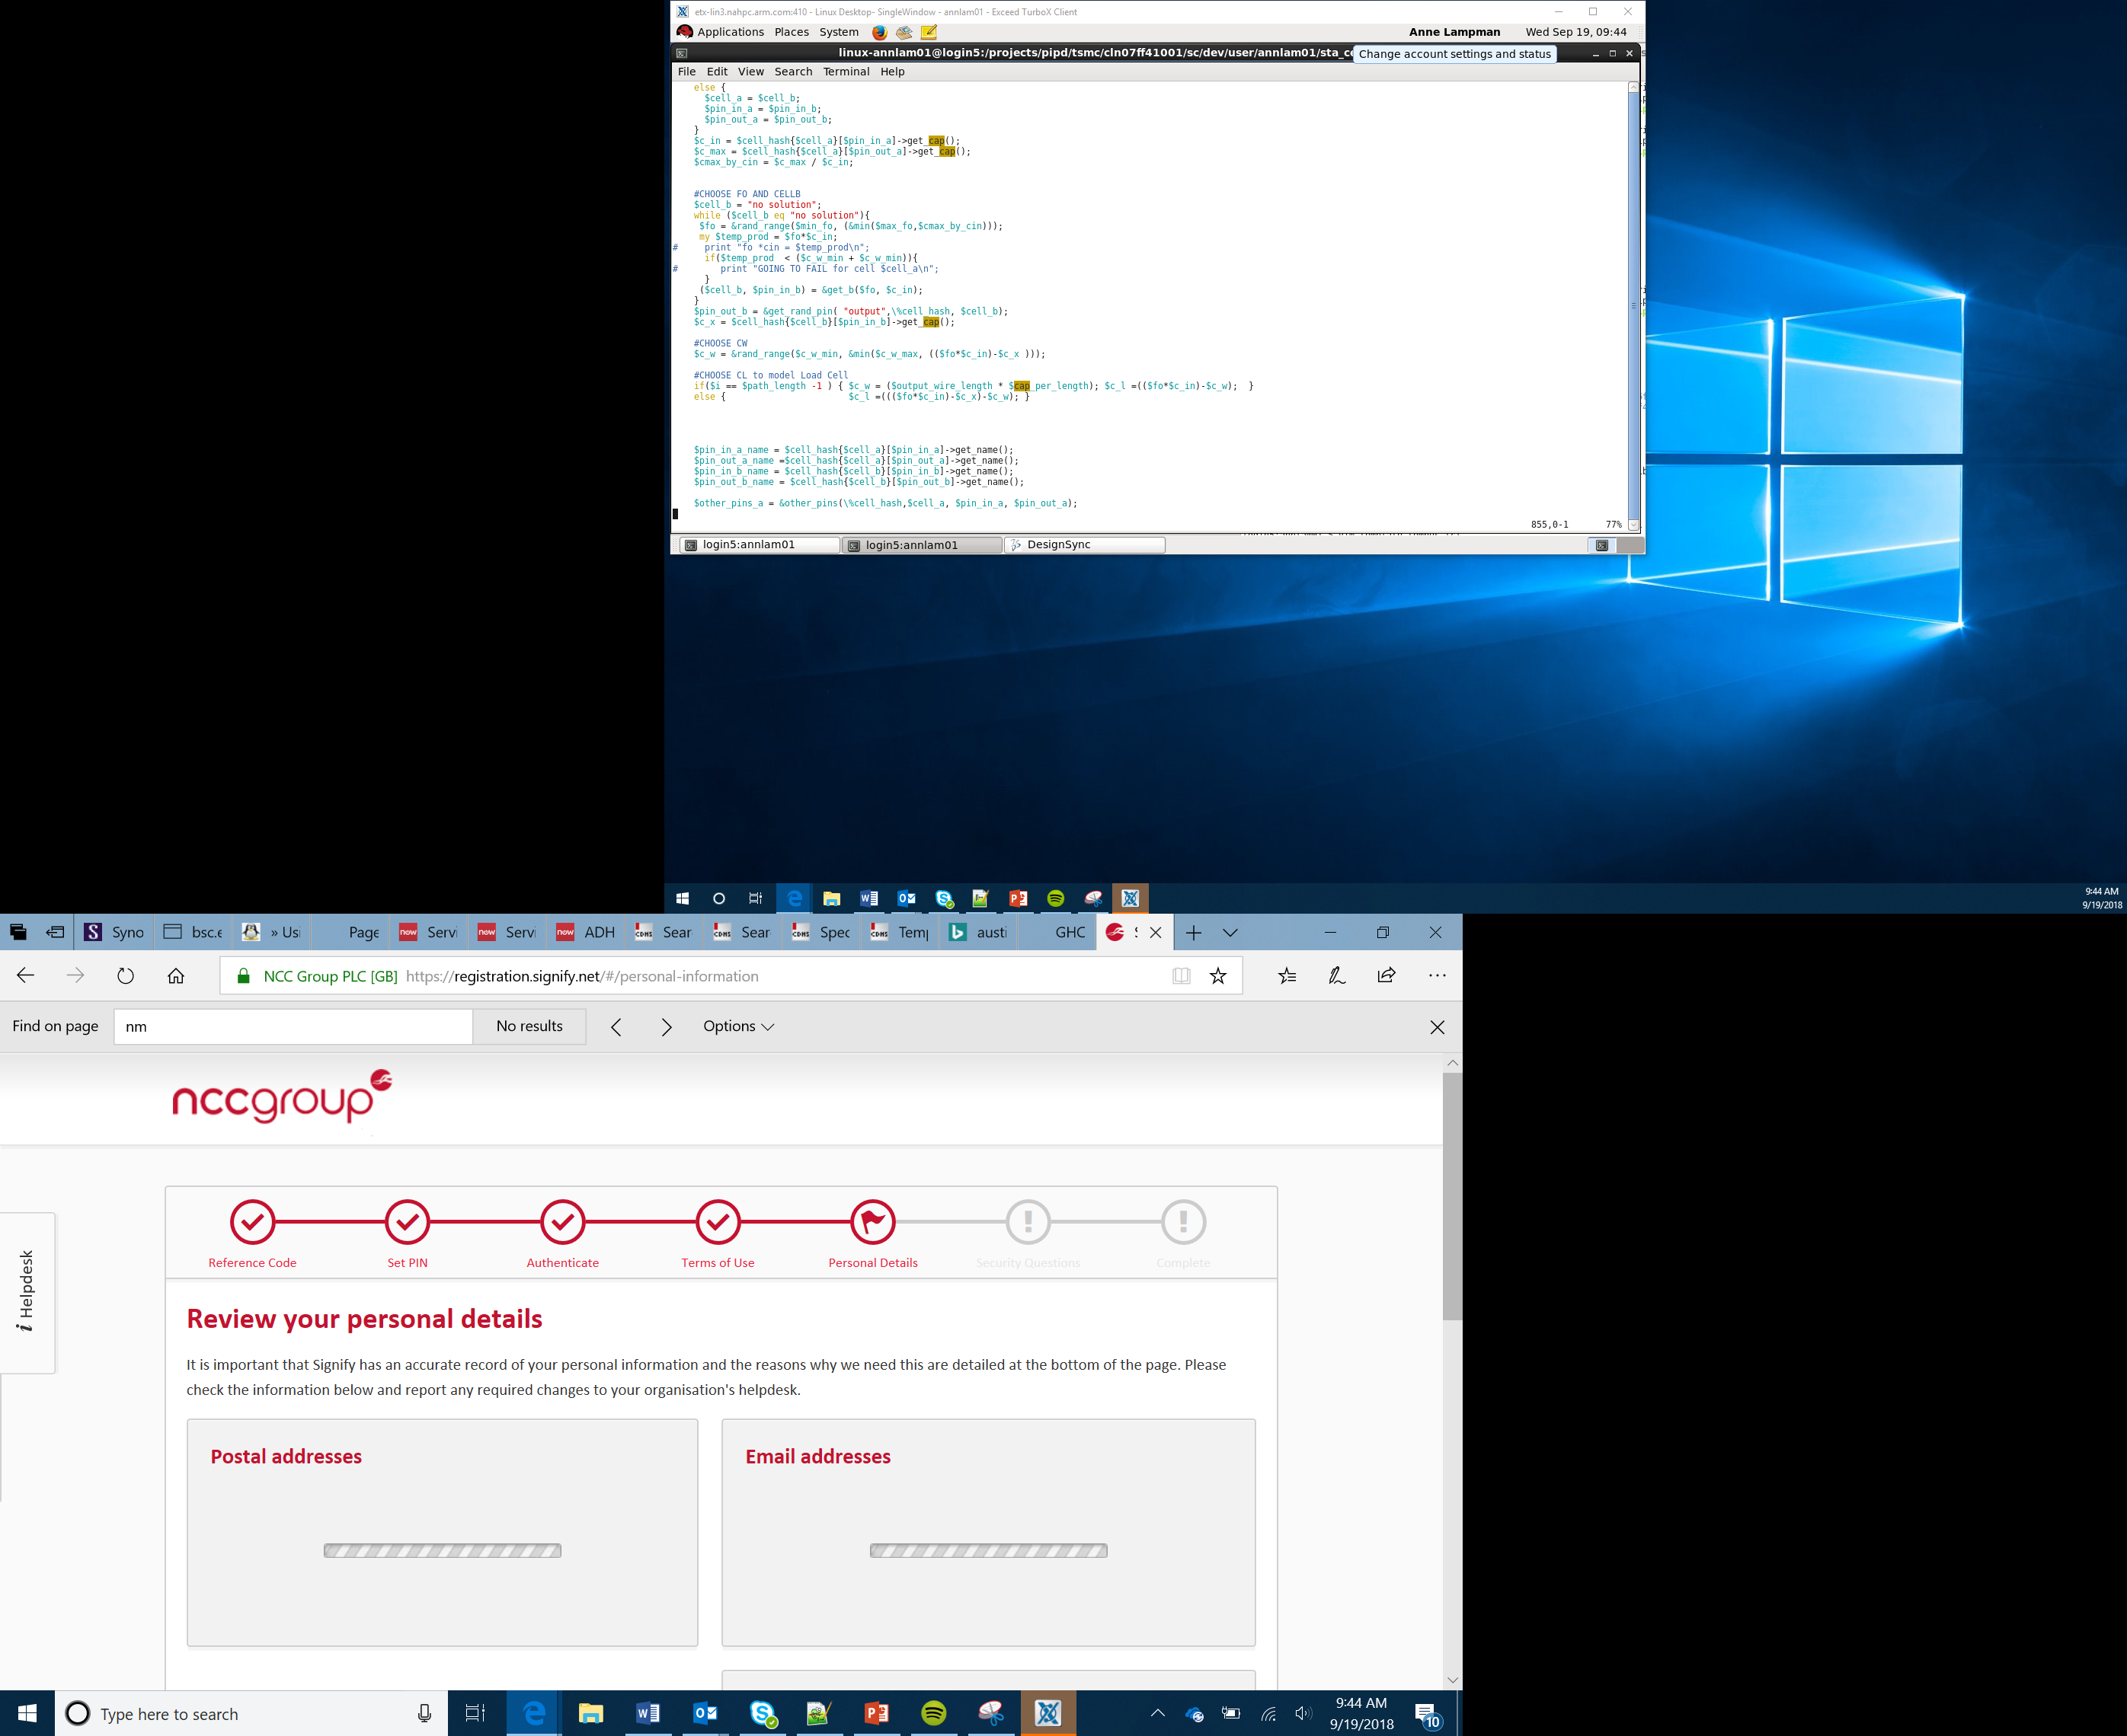

Baseball bat metrics
Lesson 4

Slide 2
Can be attached to a baseball bat securely
Measures the movement of a baseball bat
Records the data during a bat swing onto the Arduino IoT cloud
Success criteria
Notes:
Discuss the purpose of the project. Ask if any students know which sensor may be used. Some may suggest a sensor which can detect acceleration or movement. The sensor which measures acceleration is called an accelerometer. Students should think about how they can control sprites on a mobile phone – this also uses an accelerometer.

Slide 3
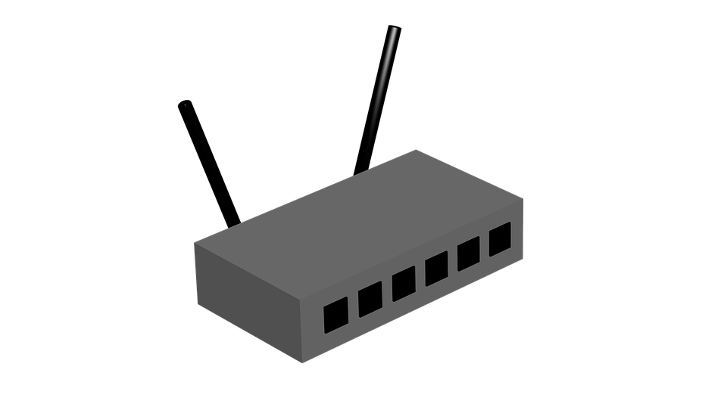


3/4/5G
WiFi
LoRa
Sigfox
Long range
Arduino Cloud
Dashboard
GATEWAY
(to the internet)
Process:
Node transmits to gateway over a long range using 3G (mobile network) or LoRa/SigFox
Gateway receives data and then transmits it to the internet
Live data is viewable on the IoT Dashboard
NODE
Notes:
Discuss how the device will connect to the IoT. The sensor will be attached to the Arduino board which will then transmit the data either via WiFi or aLoRa. Highlight to students that 4g and 5g could also be used if they have a suitable board. This will then upload the data to the Arduino cloud and will be displayed in a custom dashboard. Students should then complete the IPO document.

Slide 4

Sensing acceleration
Acceleration is defined as the change in velocity over a period of time
Velocity is not the same as speed
Velocity has a direction: 25 kilometres per hour (kph) is a speed whereas 25kph east is a velocity
Imagine a car: the faster the change in velocity, the quicker its acceleration
Notes:
Discuss what acceleration is. Consider a car. Stress that velocity is not the same as speed. It is the change in velocity over a set period of time.

Slide 5

Acceleration and the accelerometer
An accelerometer measures changes in acceleration
Acceleration is calculated using Newton’s classic equation
Force = mass x acceleration
Therefore acceleration = force / mass
Notes:
Highlight that an accelerometer measures acceleration across three different axis. Discuss the formulae which learners may have come across in their Physics lessons. There is a good opportunity here for a cross-department project.

Slide 6
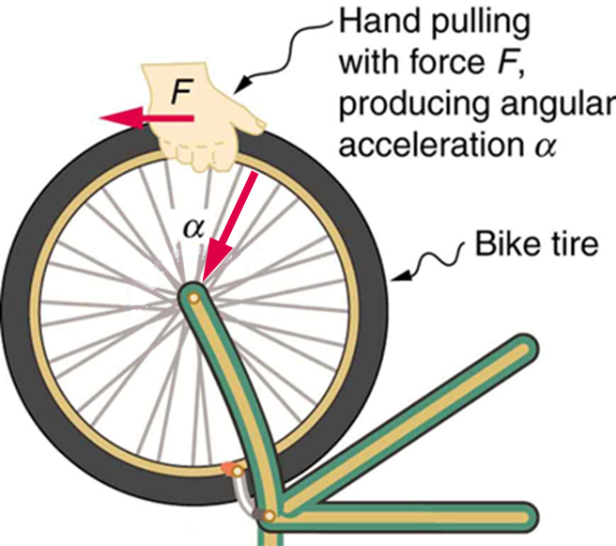
Acceleration and the accelerometer
Acceleration = force / mass
Consider riding your bike, as you ride your bike, the mass does not change
However as you speed up, slow down, turn and brake the force will change
Therefore the new acceleration can be calculated
Notes:
Ask students to think about when they ride their bike. They either pedal or brake to change acceleration.

Slide 7
The accelerometer
The three-axis accelerometer contains a tiny electrode that moves whenever the sensor is moved
If the force is enough the electrode makes contact with other electrodes
This contact makes a circuit and a digital signal is then sent back to the program
This digital signal is processed and interpreted to establish the amount of acceleration

Slide 8
Three axes – x, y and z
Think about an Aeroplane – it can move:
Up and down
Forward and back
Left and right
If we pair these up, we get three axes – x, y and z
Acceleration can occur along each of the three axes x, y and z
y
Up
Back
x
left
Right
Fwd
Down
z
Notes:
Highlight that the accelerometer will take three different readings. These will be across the x, y and z axis.

Slide 9
Your task
You should now create a device which can measure the acceleration of a baseball bat as it moves towards hitting a ball
The device should be tested initially without being attached to a bat
Once the device is working, it should be securely attached to a baseball bat
Notes:
It is recommended that the device is fully tested prior to being attached to a bat. In order to attached it to a bat, it is recommended that the device is wrapped in packing foam to protect it. It should be attached to a part of the bat which won’t make contact with the ball. The sensor could be attached to the bat using cable ties and gaffer tape. It would be worth considering having the Arduino attached near the handle and then just the sensor at the end of the bat. More capable students could think about the impact on the measurements that having the sensor attached to different parts of the bat would have.

Slide 10
Summary
The accelerometer measures acceleration across three different axis
The Arduino is capable of connecting to different forms or wirelesss network
The accelerometer uses electrodes to detect movement

